Slide 1
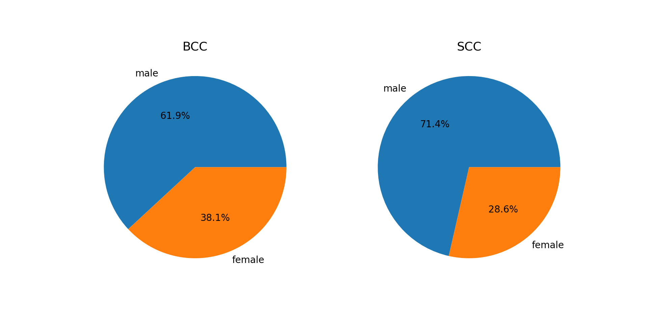
Supplementary Figure 1a:
Notes:
Supplementary Figure 1a: Gender distribution of patients

Slide 2
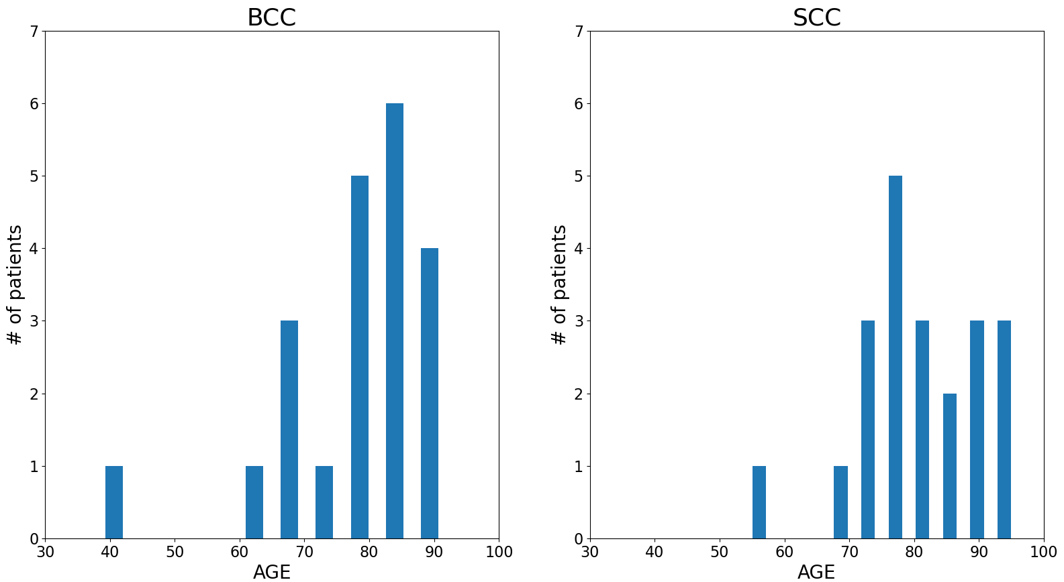
Supplementary Figure 1b:
Notes:
Supplementary Figure 1b: Age distribution of patients

Slide 3
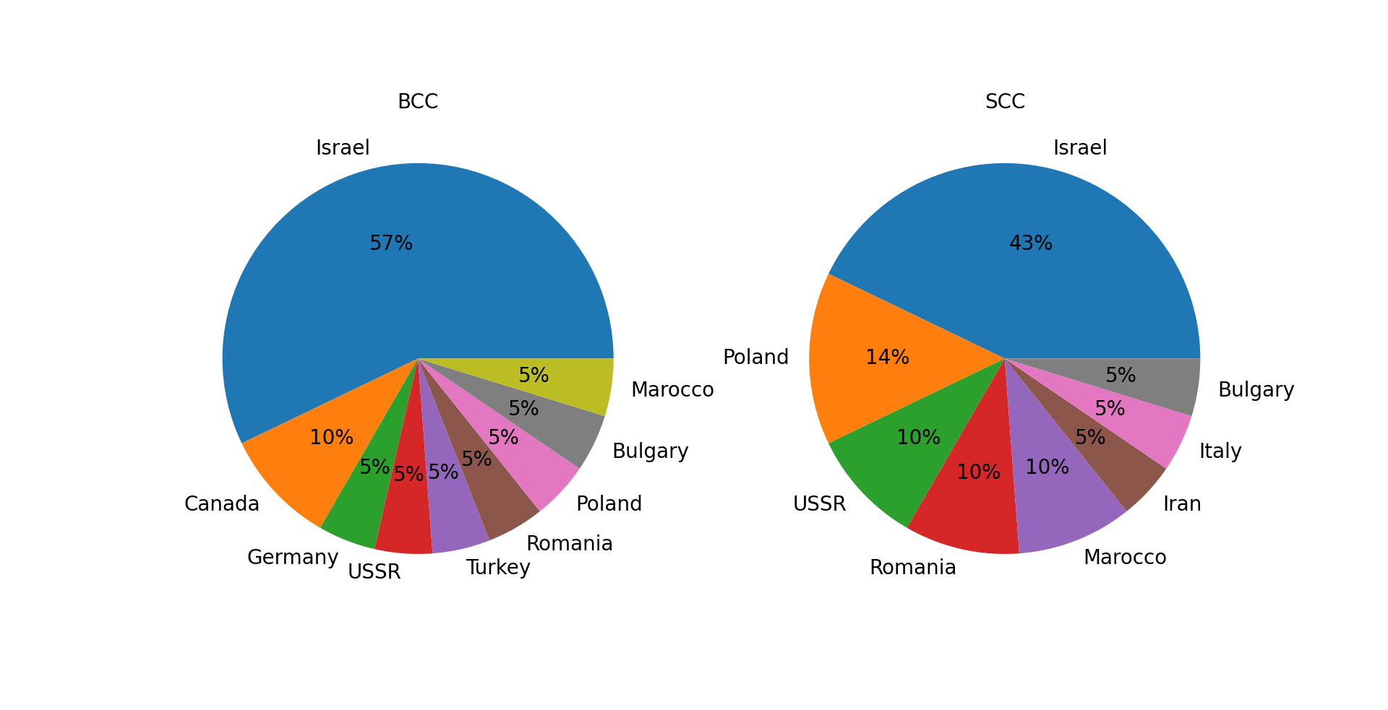
Supplementary Figure 1c:
Notes:
Supplementary Figure 1c: Distribution of patients’ place of birth

